Slide 1
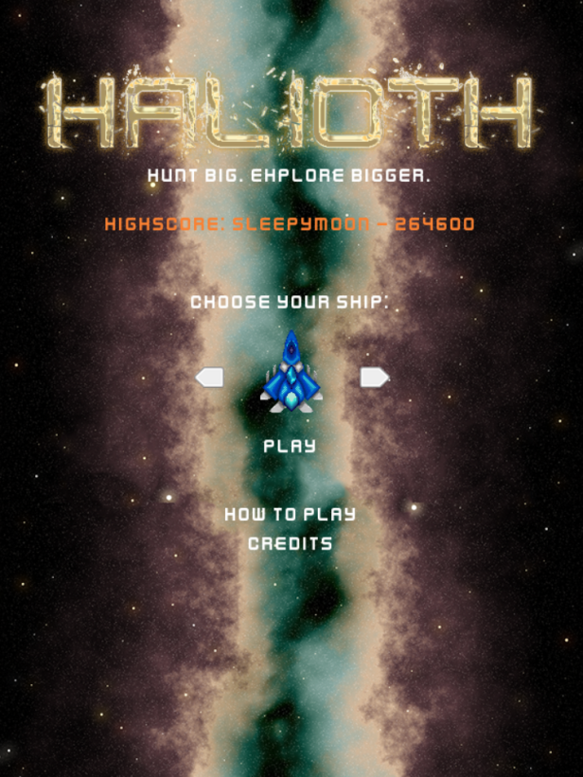
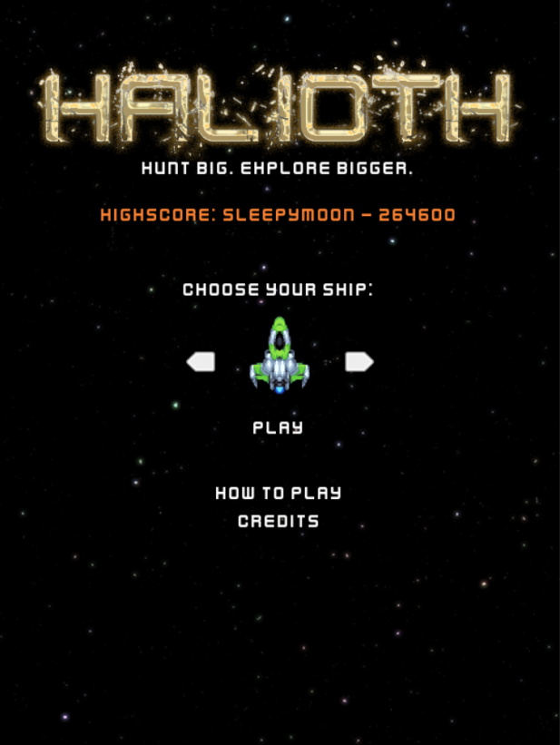
Halioth
Haoming Meng and Lucas Zhou

Slide 2
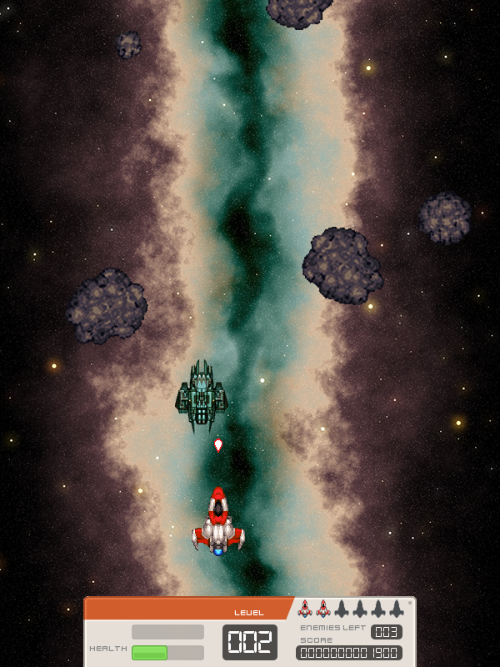
Overall game
Space shoot’em up game
Player controls a spaceship
Objective is to clear enemy mobs (enemy ships and asteroids)
Complete as many levels as possible
Score as high as possible
Starts with 3 lives
Gains a life for every completed level
Max 6 lives at a given time
Plenty of sound and music

Slide 3
User gameplay and controls
In game, player controls ship bilaterally using left and right arrow keys
Space bar to shoot bullets (can hold for continuous firing)
P for pause menu
Can use keyboard (C to continue, esc to quit, etc.)
Can use mouse (Clickable buttons)
Player has a health bar indicating how much is left in the current life

Slide 4
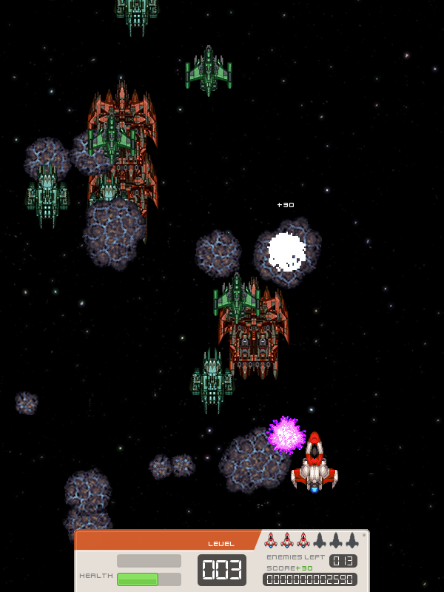
Enemy mobs
Three types of enemies
Large enemy ship ~ 200 points
Smaller ones (two small ships) ~ 100 points
Can all fire back at the player’s ship (player can lose health)
Three asteroid sizes
Large asteroids ~ 30 points
Medium asteroids ~ 20 points
Small asteroids ~ 10 points
NOTE: If a mob reaches past player to the bottom of the screen, amount of points worth is deducted from score

Slide 5
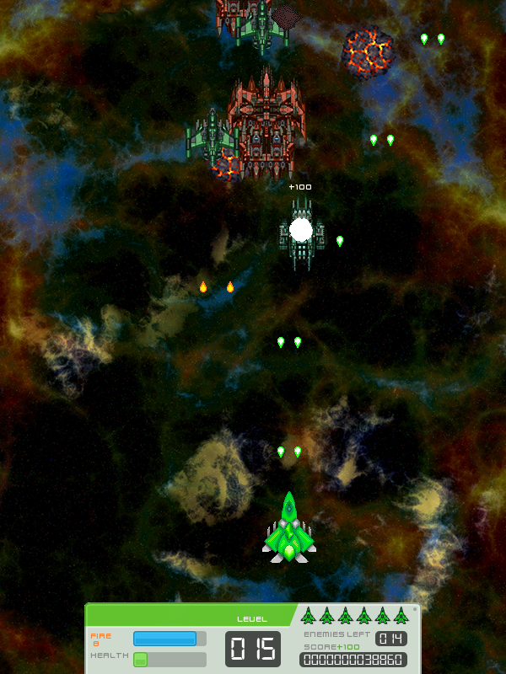
Power ups
Fire Power Up:
Appears as a red energy ball
Allows two streams of bullets with increased frequency for 10 seconds
Speed Power Up:
Appears as a blue energy ball
Allows increased speed of player for 10 seconds
Health Power Up:
Appears as a green energy ball
Fills up health bar to full health

Slide 6
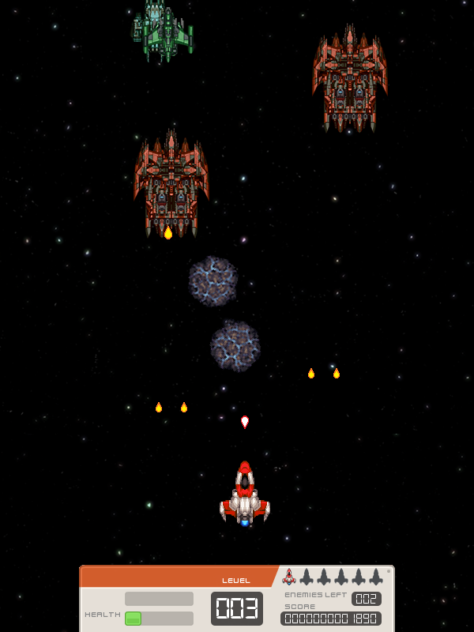
Level structure
Player has to clear predetermined amount of enemies without losing all of their lives in order to move on to the next level
A module with a general formula for all levels was created to continuously loop
100 levels!
Each progressive level will become greater in difficulty
Number of mobs increase as well as their respective speeds and firepower

Slide 7
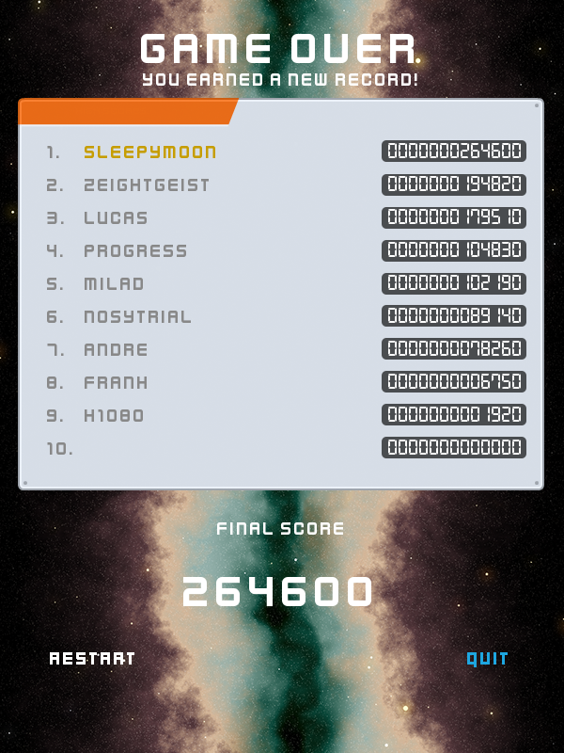
Extra features
Leaderboard
Displays top 10 scores and usernames
Max 14-char (highlight in yellow)
A separate text file was used
Same directory as the script
Program reads the scores from the file, can write to it if new score is recorded

Slide 8






Extra features
Customizable Ships
Player can choose from two types of ships
Each has three colours (blue, green, and red)

Slide 9
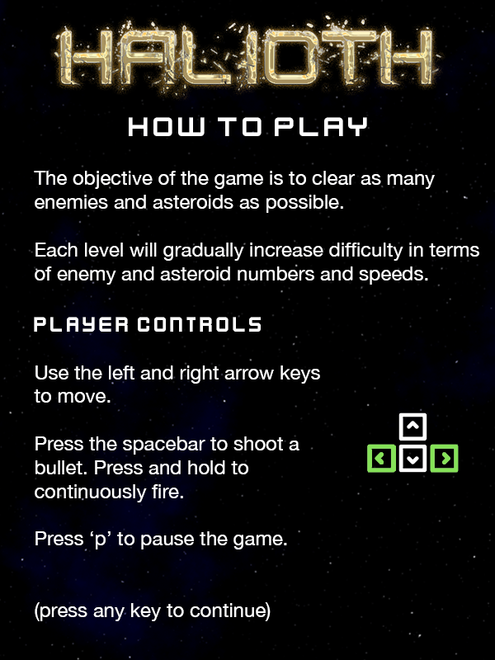
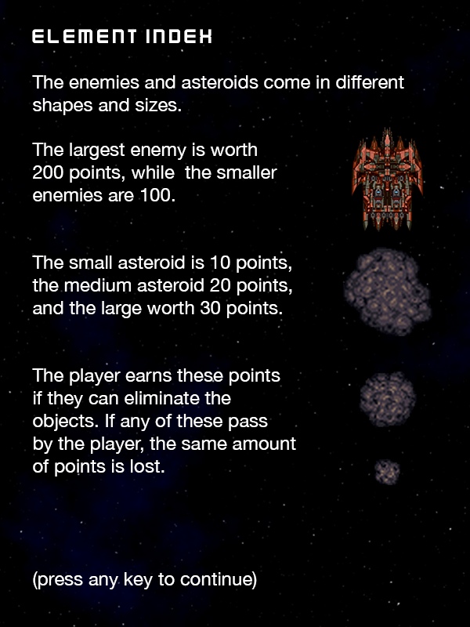
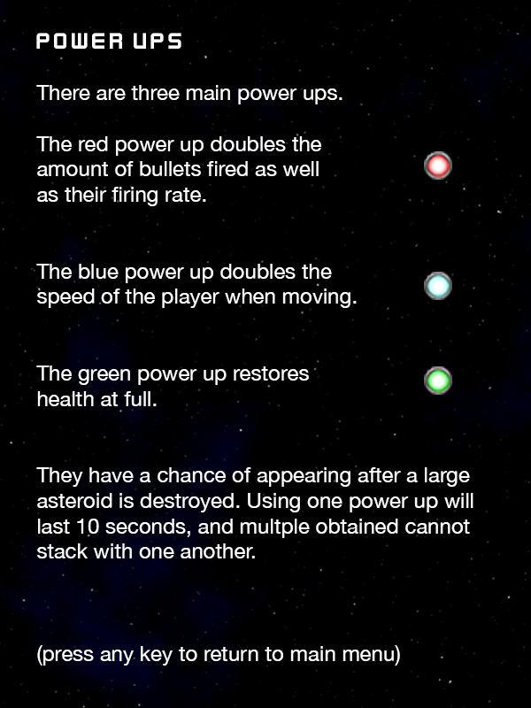
Extra features
Instruction Screens

Slide 10
Extra features
Cheat Codes
‘r’+’9’ to go to the 99th level
‘r’+’0’ to go to the 100th level

Slide 11
Thanks for listening

